Slide 1

TRANSFORMING LIVES THROUGH POWER

Slide 2
THE PROBLEM WE ARE SOLVING
POWER SCARCITY

Slide 3
VOLTAN THE SOLUTION
A
BIOGAS PRODUCTION
A CLEANER AND AFFORDABLE ENERGY NOW MADE SMART THROUGH AI TECH AND READY AVAILABLE TO BE USED TO COOK.
B
POWER GENERATION
AN AI GUIDED SYSTERM THAT ENSURES EFFICIENCY AND SUSTAINABILTY OF OUR POWER STATIONS.
C
THE AGE OF ELIGTHENMENT FOR Nigeria
WE WANT TO BRING OUT AN AGE OF ELIGTHENMENT TO NIGERIA TO SHOW OUR COUNTRY MEN , THE TRUE POWER OF BIOGAS AND AI TECH
WE INTEND TO MAKE AS MUCH IMPACT AS POSSIBLE.

Slide 4
OUR ROAD MAP
(BY UTILIZING AI AND BIO TECH )
IDEA PROTOTYPING AND TESTING
RETAIL OF OUR BIOGAS AND OTHER PRODUCTS.
SECURING INVESTMENT AND PARNTERSHIP FOR GOALS.
SETUP OF OUR BIOGAS ELECTRO-STATION AND RETAIL OF OUR ELECTRICITY AND OTHER PRODUCTS
CUSTOMER DISCOVERY STAGE
COMMUNITY OUTREACHES ON THE USES AND IMPORTANCE OF BIOGAS WITH ITS BY-PRODUCTS
ENSURING WE MAKE AS MUCH IMPACT AS POSSIBLE

Slide 5
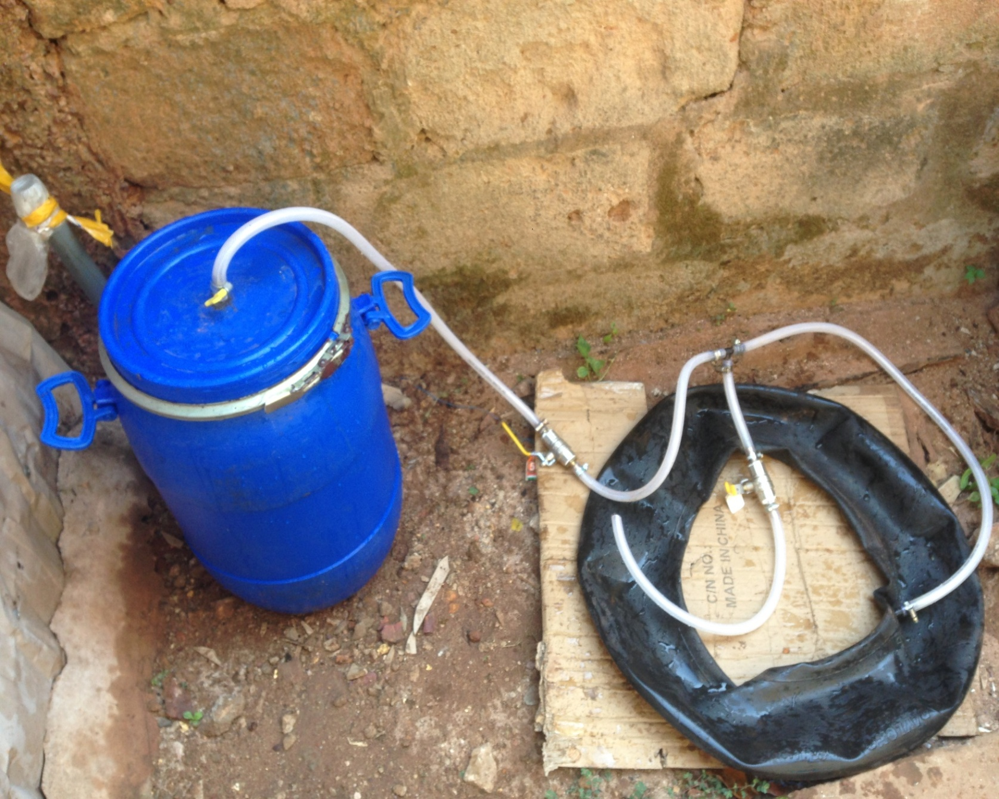
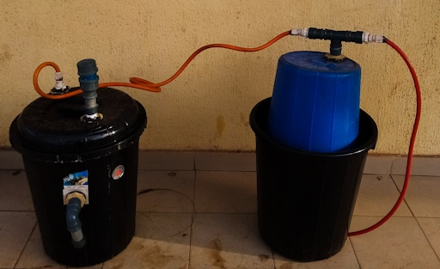
WHERE WE ARE NOW
CURRENT PROTOTYPE
FIRST PROTOTYPE

Slide 6
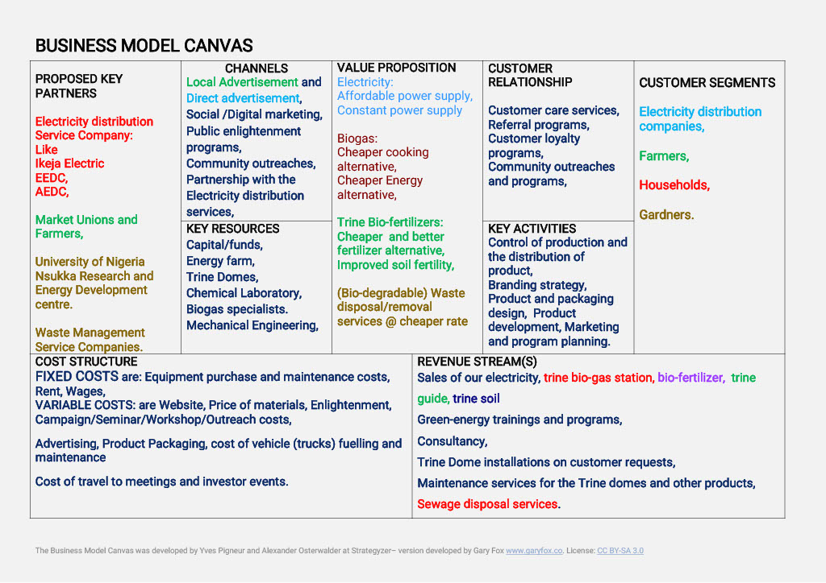

Slide 7
SOME OF OUR PRODUCTS IN DETAIL:
THE PROTOTYPE:
PRODUCT PROTOTYPING AND DEVELOPMENT USING AI AND BIO TECH(MAIN PROGRAM THE SMART AND THEN PROTOTYPING WITH BIOGAS RESEARCH /DATA),
THE FIRST PRODUCT:
LAUNCH OF OUR FIRST PRODUCT THAT IS THE PIT CONVERSION , WITH THE AID OF OUR BIOGAS RESEARCHED WE WILL CONVERT HOUSE TOILET/SEWAGE PITS INTO BIOGAS DIGESTERS WHICH WILL PRODUCE BIOGAS THAT CAN BE USED TO COOK AND ATTACHED TO THE HOME PITS ARE OUR PROGRAMMED SMART WHICH MENTORS THE DIGESTER CONDITION TO ENSURE EFFICIENT GAS PRODUCTION AND THE SAFTETY OF THE USERS.
THE GREEN ENERGY OUTREACH:
NOW WE INTEND TO ENLIGHTEN THE PUBLIC BEFORE THIS ALTERNATIVE ENERGY AND WHAT THE SMART SYSTERM CAN HELP DO FOR THEM.
THE BIO-FERTILZER
ITS AN EXACT BY-PRODUCT OF THE DIGESTION PROCESS AND ITS VERY RICH IN NURIENTS FOR CROP/PLANTS GROWTH AND DEVELOPMENT.

Slide 8



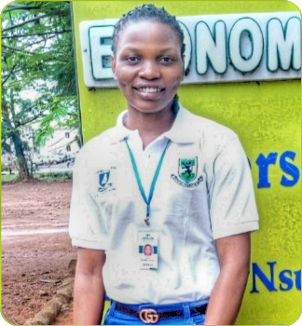
OUR TEAM
GLORY AMADIFE
CO-FOUNDER
MMERICHUKWU ANOSIKE
CO-FOUNDER
JOY OGUMBA
RESEARCHER / MEDIA OFFICER
MADU A. DANIEL
STARTUP MENTOR

Slide 9

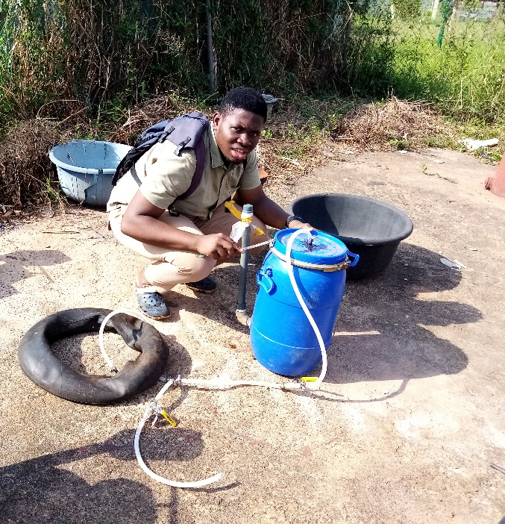
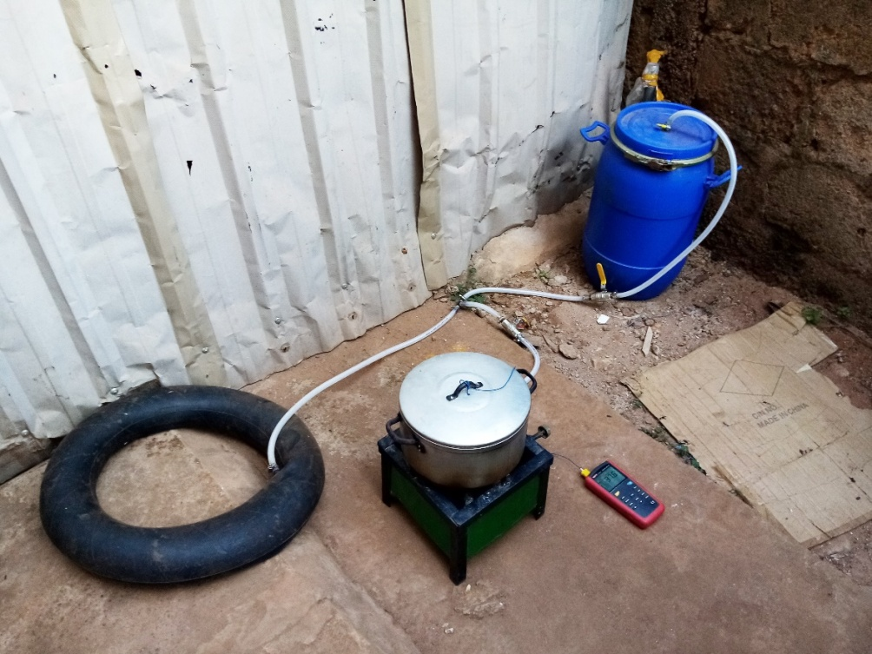
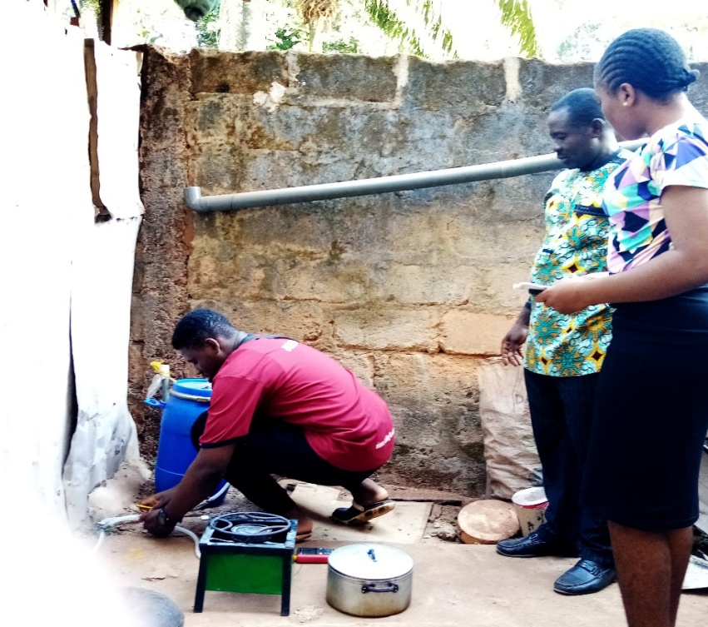
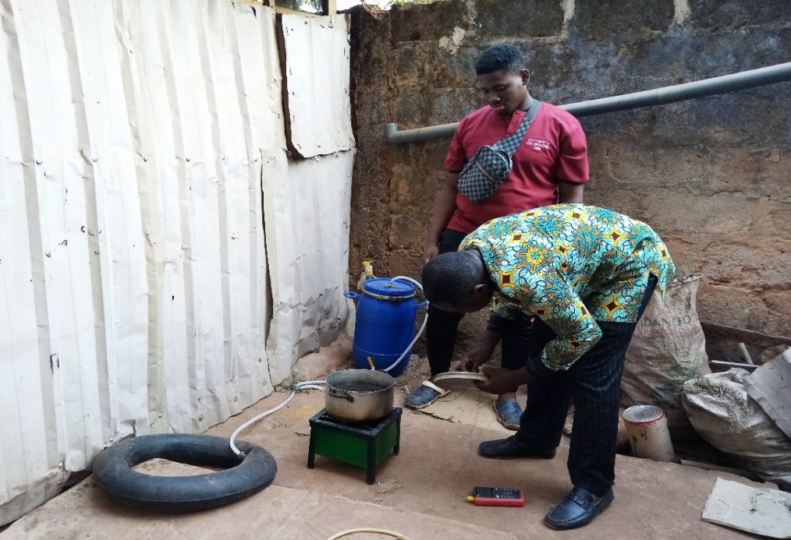
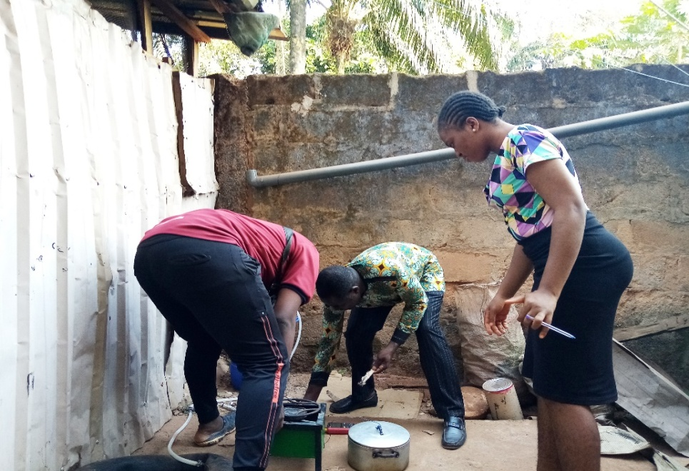
CURRENT PROGRESS IN PICTURES

